Slide 1
Duo Universal Prompt
Two-Step Login Training
2/22/2024 and 2/27/2024

Slide 2
Introduction

Slide 3
Duo Universal Prompt Training
Your Trainer Today:
Melanie Ferstman
Training Specialist
Information Services
Notes:
Intro of self: University, corporate, etc. - instructional design and training
Purpose of training: Increase proficiency with updated Duo Universal Prompt
Let's get started!

Slide 4
Learning Objectives
Learning objectives help you understand why you are in training and know what you will be able to do by the time we finish today. Remember that there will be Q&A at the end of training.
After training, learners will be able to:
Register their devices
Select their authentication method
Use biometric verification
"
Notes:
Learning objectives: goal setting and answer: What will I be able to do at the end of the training?
Initially use Verified Duo Prompt
Choose how you would like to verify your identity
Choose to use biometric, or person-centric data through devices like your fingerprint

Slide 5
Why Is the Duo Prompt Changing?
Improvements for your online safety.
Improvements for better usability, like remembering your last-used verification device and automatically choosing it again.
Duo is requiring all its customers to upgrade to the Duo Universal Prompt in the next few weeks.
Notes:
Reasons for changes include:
Security for your access to UO technological services
Use the Duo Universal Prompt more efficiently and easily
Requirements: Technologies update their products regularly
Time to look at the Duo Universal Prompt now.

Slide 6
Verified Duo Push

Slide 7
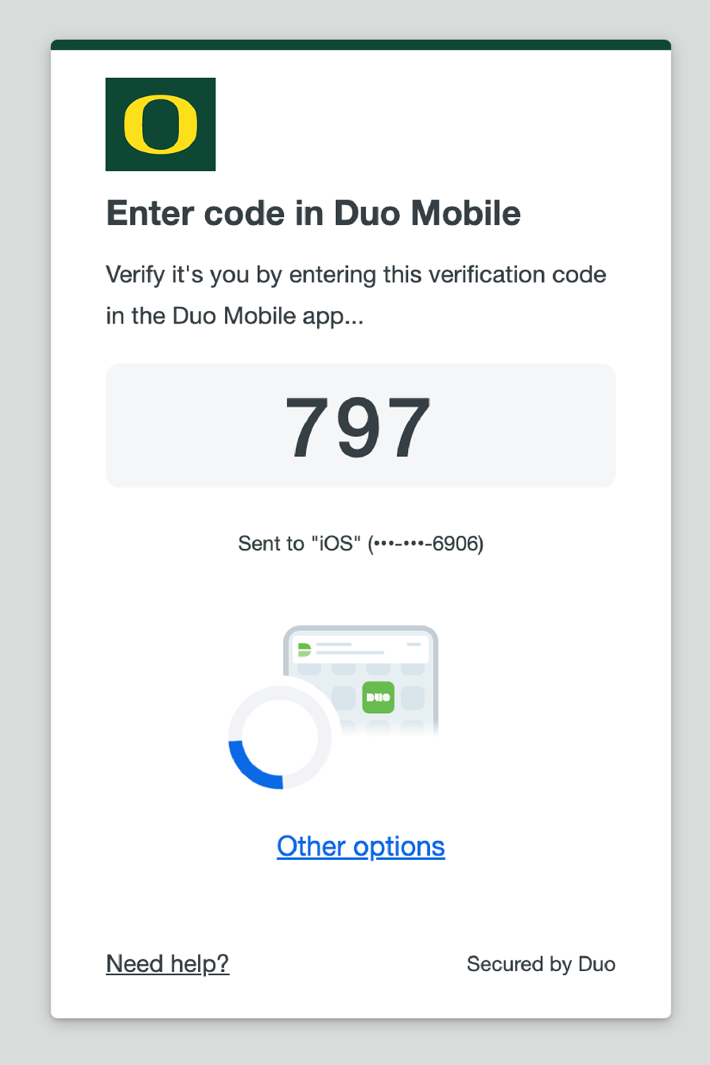
What Is Verified Duo Push?
Features of Verified Push
Enter a three-digit code instead of clicking Approve
Use the same devices you've always used with Duo Push
Updated look and feel to the Verified Duo Push screen
Benefits of Verified Push
Greater login security
Consistently access your applications
Easier to read and respond to Verified Duo Push prompts
Notes:
Verified Duo Push:
Increased login safety: generate a three-digit code on device you're using to log into UO services and enter the code into Verified Duo Push
Continue to use the devices you're already set up with – efficiency and ease of use
Cleaner look and feel to revised appearance -- simplicity

Slide 8
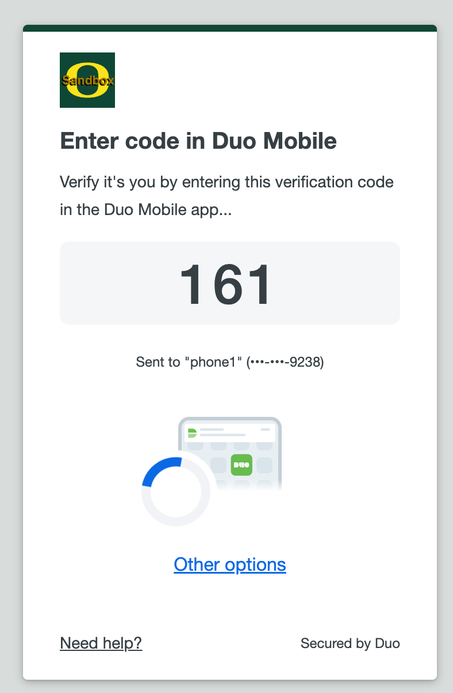
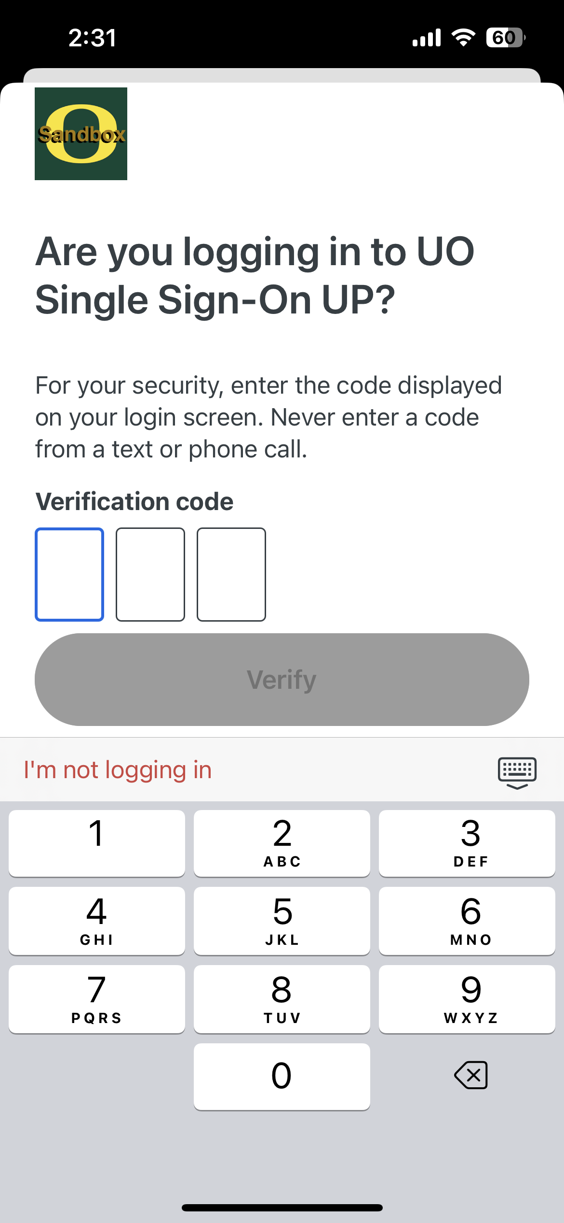
Demo 1: Steps 1-2
From Step 1:
From Step 2:
Step 1: When you log in to a Duo-protected service, a Verified Duo Push's three-digit code will appear on your computer or device.
Step 2: Enter the three-digit code into the Duo Mobile app.
Notes:
As you log into a Duo-protected service, you will see on-screen updates:
First, Verified Duo Push appears on the screen you're using to log in to your online service.
Next, you enter same three-digit code into Duo Mobile in whatever way works best for you.

Slide 9
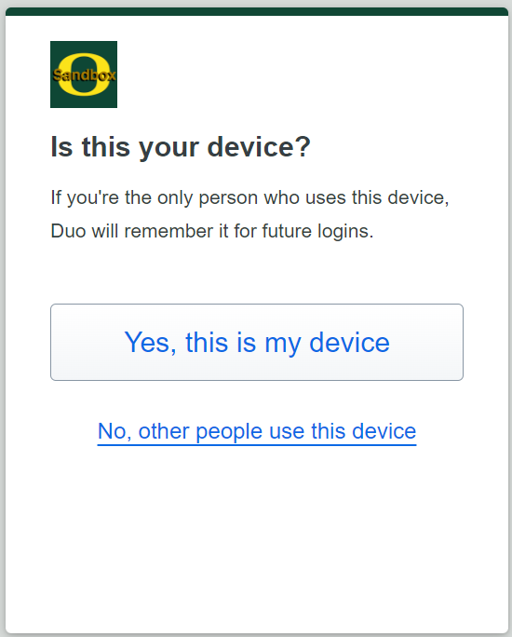
Demo 1: New "Remember Me"
The Is this your device? screen will appear.
If you click the Yes, this is my device button, the Duo Universal Prompt will save your settings for seven days.
If you share your device, click No, other people use this device.
For the next 14 days, you will see the Duo Universal Prompt every time you log in to the same device.
Both link you to the application you are logging into.
Notes:
Important to note:
When then see following, two choices appear.
Yes, this is my device button and No, other people use this device link.
When you click the button for "Yes, this is my device," 7-day memory of your Verified Duo Push access.
When you click the link for "No, other people use this device," 14-day memory of your response. Verified Duo Prompt will require Duo Universal Prompt login for next 14 days.
Emphasize: Always click the "No, other people use this device" option on shared or public computers for the sake of security.

Slide 10
Demo 1: Verified Duo Push Live
Live Demo Learn how Verified Duo Push works in real time.
Notes:
Come back to this slide.

Slide 11
Verification Choice

Slide 12
Choosing a Different Verification Method
Choose a Duo verification option from most to least secure:
Biometric identification
Duo Mobile push approval
YubiKey passcodes
Duo Mobile generated passcodes
Hardware token passcodes
SMS passcodes
Phone call approval
With the Duo Universal Prompt, you can choose a different verification method to log in using the new Other options link.
Notes:
You can choose to verify your identity in the Duo Universal Prompt in a variety of ways:
Two popular methods to verify your identity include the strongest options from security point of view: biometric ID and Duo Mobile Push approval.
Emphasize: All methods are secure. Some increase security more, including biometric identification and Duo Mobile Push approval.

Slide 13
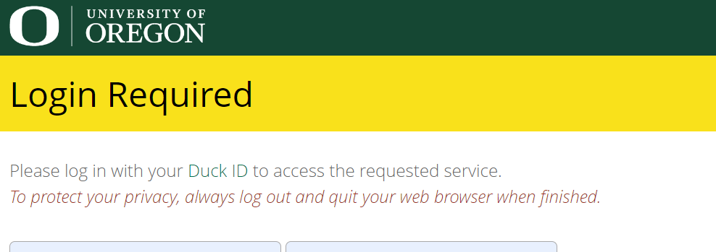
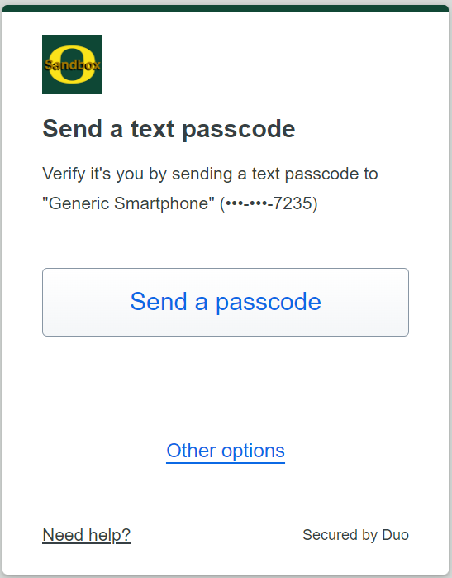
Choose a Different Verification Method (Steps 1-2)
Step 1: Log into a Duo-protected service.
Step 2: In the Verify your identity screen, click Other Options to select a different verification method.
Notes:
To choose a different way of verifying your identity when you log into a service, click Other Options.
2. Other options takes you to screen with list of verification methods.

Slide 14
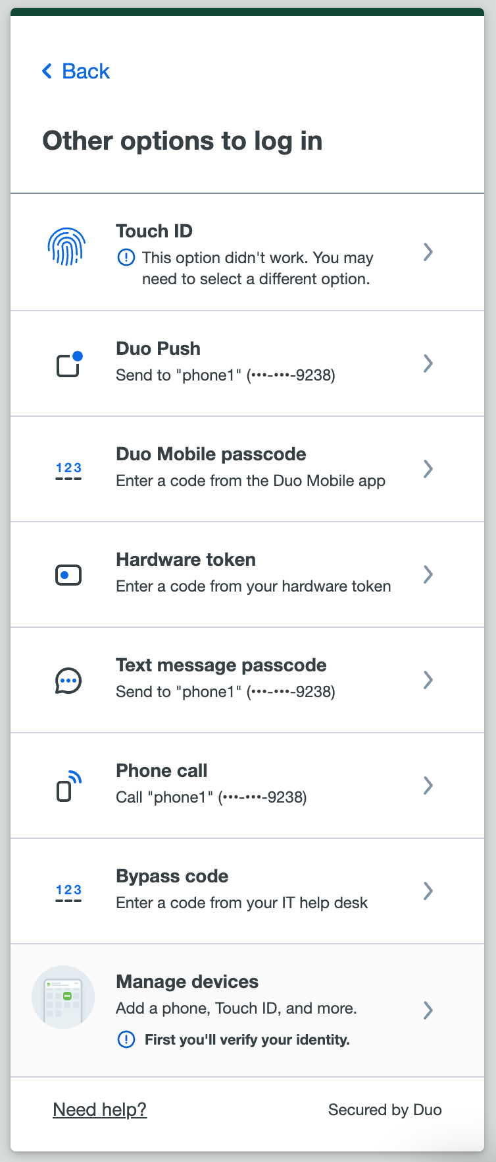
Choose a Different Verification Method (Steps 3-4)
Step 3: Choose a verification option
in Duo Mobile.
Step 4: Log in using your new authentication choice by following the steps on the Duo Universal Prompt.
Notes:
3. Review verification options for your selection.
4. Follow the steps in your verification device to log in.

Slide 15
Biometric Verification

Slide 16
What is Biometric Verification?
Biometric verification allows you to use a personal feature, like your fingerprint or an image of your face, to log into Duo Universal Prompt. Biometric verification only works for logging into services on the device with the biometric feature.
With the Duo Universal Prompt, you now have the option to use the biometric verification methods, including:
Touch ID on Mac laptops
Face ID or Touch ID on iPhones and iPads
Android Biometrics
Windows Hello (on personal Windows computers)
Notes:
A way to explain how biometric verification works:
If you have Face ID set up on your iPhone and you're logging in to a Duo protected service on your iPhone, you can enable Face ID on that iPhone to log in on that device.
This approach allows you to use two verification steps (e.g., what you know, like a fingerprint, and what you have, like a device) using a single device with the capability. With biometrics, what you know (your fingerprint information) and what you have (your passcode device) are one item: the biometric feature on your device, like a phone.
Key point: Biometric verification only works for logging into services on the device with the biometric feature. If you want to log into a service on your laptop, for example, it helps to have Touch ID set up with the Duo Universal Prompt already.

Slide 17
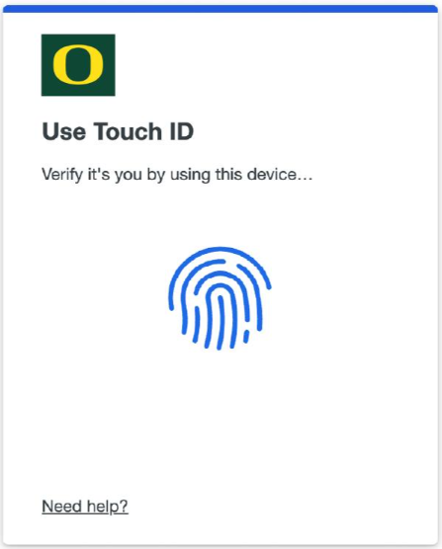
Demo: Other Authentication Methods, Apple Touch ID (Laptop/Keyboard)
Touch your Mac's Touch ID sensor when prompted to log in to the application.
Notes:
Before you start, be sure you're using:
A MacBook Pro, MacBook Air, or Magic Keyboard with a Touch ID button.
A fingerprint enrolled in Touch ID (see how to do this at the Apple Support site).
A supported browser: Safari or Chrome.
iCloud Keychain sync enabled on all the Apple devices you will use with Duo and the passkey you will create during setup.
To begin Step 1: Touch your Mac's Touch ID sensor when prompted to log in to the application. If you aren't able to access the Touch ID sensor (such as when you close and dock your laptop), then you can choose to type in your Mac login password instead to verify.
If you need to cancel a Touch ID authentication in progress, click or tap the cancel option shown by your browser, outside of the Duo Universal Prompt.
Step 2:

Slide 18
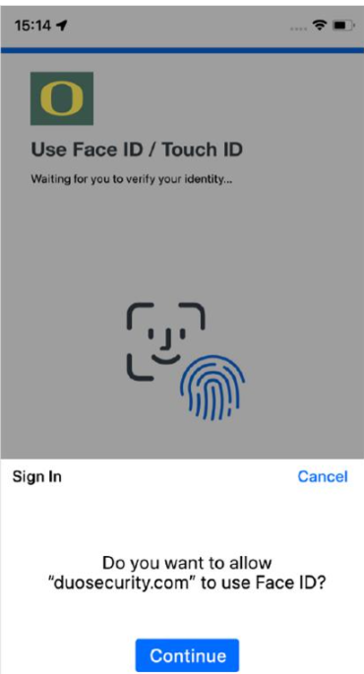
Demo: Other Authentication Methods, Apple Touch ID/Face ID (iPhone/iPad)
Depending on the option your device supports, you'll either scan your face to use Face ID while logging in, or you'll scan your fingerprint instead to use Touch ID.

Slide 19
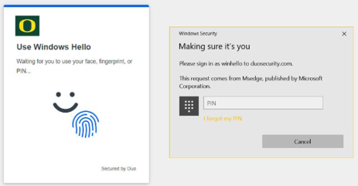
Demo: Other Authentication Methods, Windows Hello
Follow your device's prompt to enter your Windows Hello PIN, scan your fingerprint, or use facial recognition to log into Duo.
Notes:
In order to use Windows Hello with Duo, make sure you have the following:
A device running Windows 10 or later.
Windows Hello set up on the device for signing in with a PIN, fingerprint, or facial recognition. Learn how to set up Windows Hello at the Microsoft support site.
A supported browser: Chrome, Edge, or Firefox.
Chrome Incognito and Edge InPrivate browsing won't work with Windows Hello, but will work with Security Keys.
Follow your device's prompt to enter your Windows Hello PIN, scan your fingerprint, or use facial recognition to log into Duo.

Slide 20
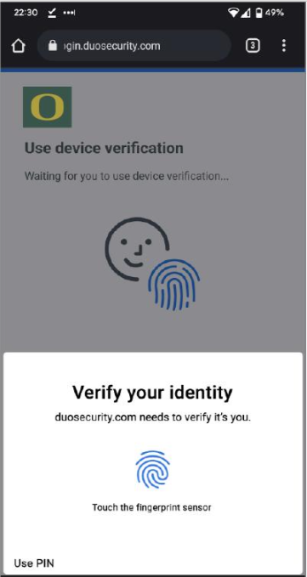
Demo: Other Authentication Methods, Android Biometrics
Follow your device's prompt to scan your fingerprint or use facial recognition to log into Duo.
Notes:
In order to use Android Biometrics with Duo, make sure you have the following:
An Android device that supports biometrics, like fingerprint or face unlock.
Facial or fingerprint unlock set up on that device. Go to Settings → Security to change your unlock settings.
For Google devices: Unlock your Pixel phone with your fingerprint and Unlock your Pixel phone with your face
For Samsung devices: Set up and use the fingerprint sensor on your Galaxy phone and Use Facial recognition security on your Galaxy phone
For other Android devices: Consult your device manufacturer's support site
Follow your device's prompt to scan your fingerprint or use facial recognition to log into Duo.

Slide 21
Conclusion

Slide 22
Duo Universal Prompt Help
There are a variety of resources beyond training to help with your individual Duo Universal Prompt learning needs:
Knowledge Base
Duo Universal Prompt Category
Duo Universal Prompt FAQ
Two-Step Login (Duo) Support
Technology Service Desk
Notes:
Variety of resources to assist:
Knowledge Base self-help: Search Knowledge Base from the Search box on UO's homepage.
The Duo Universal Prompt support page
Technology Service Desk, or TSD, the technology support we offer

Slide 23
End of presentation

